Slide 1
Welcome to
Total Quality Management
(19MEE347)
Unit 3 – Failure Mode and Effect Analysis
Name: Dr. Sunil Kumar
Department of Mechanical Engineering

Slide 2
FMEA - History
First used in the 1960’s in the Aerospace industry during the Apollo missions
In 1974, the Navy developed MIL-STD-1629 regarding the use of FMEA
In the late 1970’s, the automotive industry was driven by liability costs to use FMEA
Later, the automotive industry saw the advantages of using this tool to reduce risks related to poor quality

Slide 3
FMEA - Use
Allows us to identify areas of our process that most impact our customers
Helps us identify how our process is most likely to fail
Points to process failures that are most difficult to detect

Slide 4
FMEA – Applications
Manufacturing: A manager is responsible for moving a manufacturing operation to a new facility. He wants to be sure the move goes as smoothly as possible and that there are no surprises.
Design: A design engineer wants to think of all the possible ways a product he is designing could fail so that he can build robustness into the product.

Slide 5
What is a Failure Mode?
A Failure Mode is:
  The way in which the component, subassembly, product, input, or process could fail to perform its intended function
    Failure modes may be the result of upstream operations or may cause downstream operations to fail
  Things that could go wrong

Slide 6
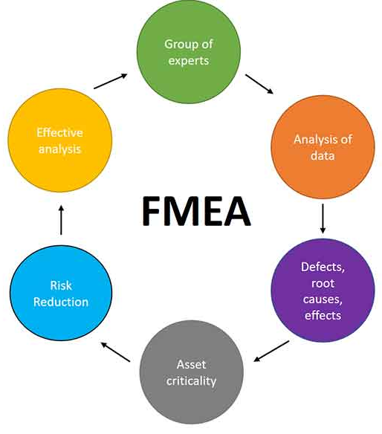
FMEA

Slide 7
FMEA
What
  Failure Modes & Effects Analysis is a methodology to evaluate failure modes and their effects in designs and in processes.
Why
  Methodology that facilitates process improvement
  Identifies and eliminates concerns early in the development of a process or design
  Improve internal and external customer satisfaction
  Focuses on prevention
  FMEA may be a customer requirement, may be required by an applicable
  Quality System Standard

Slide 8
FMEA
How
  Team identifies potential failure modes for design functions or process requirements
    They assign severity to the effect of this failure mode
    They assign frequency of occurrence to the potential cause of failure and likelihood of detection
  Team calculates a Risk Priority Number by multiplying severity times frequency of occurrence times likelihood of detection
  Team uses ranking to focus process improvement efforts

Slide 9
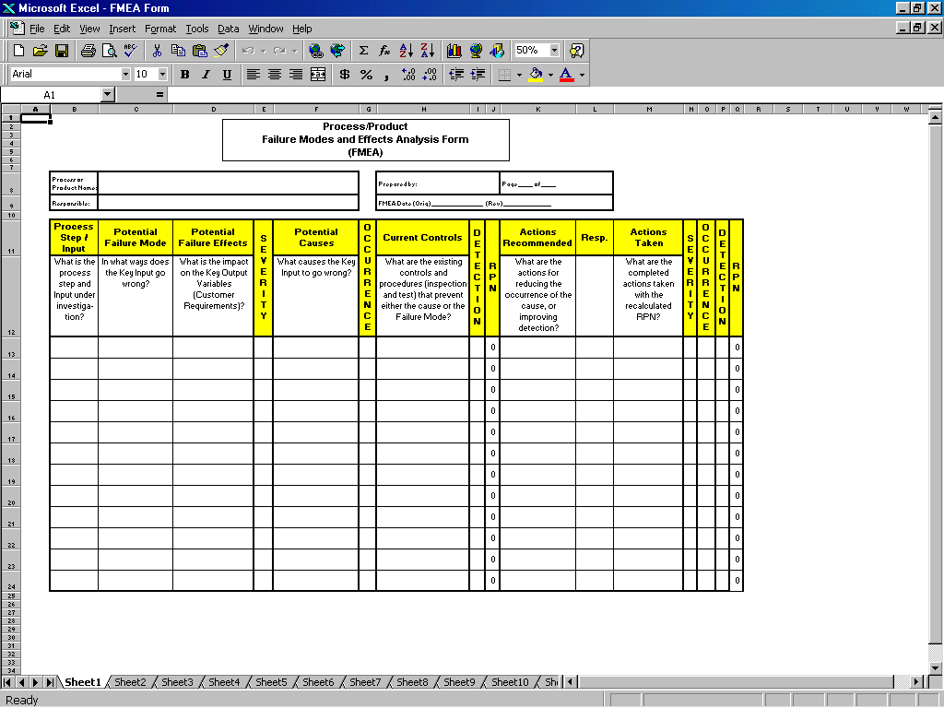
FMEA Form
Identify failure modes and their effects
Identify causes of the failure modes
and controls
Prioritize
Determine and assess actions

Slide 10
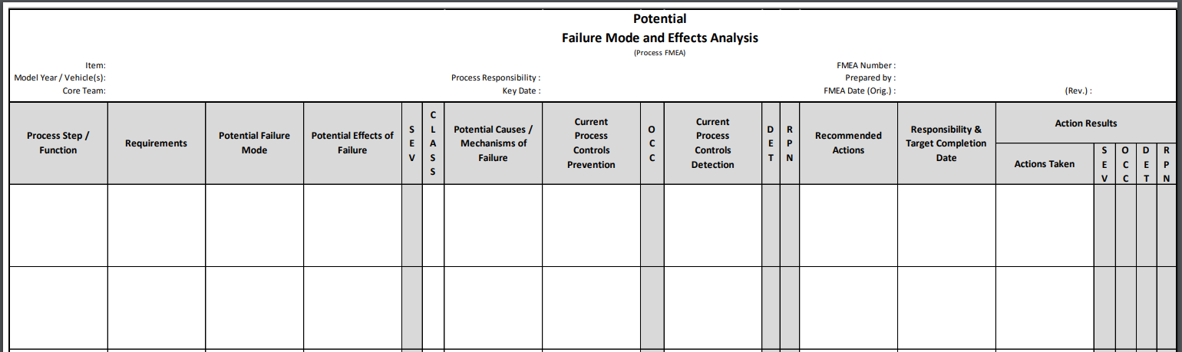
FMEA Form

Slide 11
FMEA
A structured approach to:
  Identifying the ways in which a product or process can fail
  Estimating risk associated with specific causes
  Prioritizing the actions that should be taken to reduce risk
  Evaluating design validation plan (product) or current control plan (process)

Slide 12
When to Conduct an FMEA
Early in the process improvement investigation
When new systems, products, and processes are being designed
When existing designs or processes are being changed
When carry-over designs are used in new applications
After system, product, or process functions are defined, but before specific hardware is selected or released to manufacturing

Slide 13
FMEA - Types
Design
  Analyzes product design before release to production, with a focus on product function
  Analyzes systems and subsystems in early concept and design stages
Process
  Used to analyze manufacturing and assembly processes

Slide 14
FMEA – A Team tool
A team approach is necessary.
Team should be led by the Black Belt, a responsible manufacturing engineer or technical person, or other similar individual familiar with FMEA.
The following should be considered for team members:
  – Design Engineers – Operators
  – Process Engineers – Reliability
  – Materials Suppliers – Suppliers
  – Customers

Slide 15
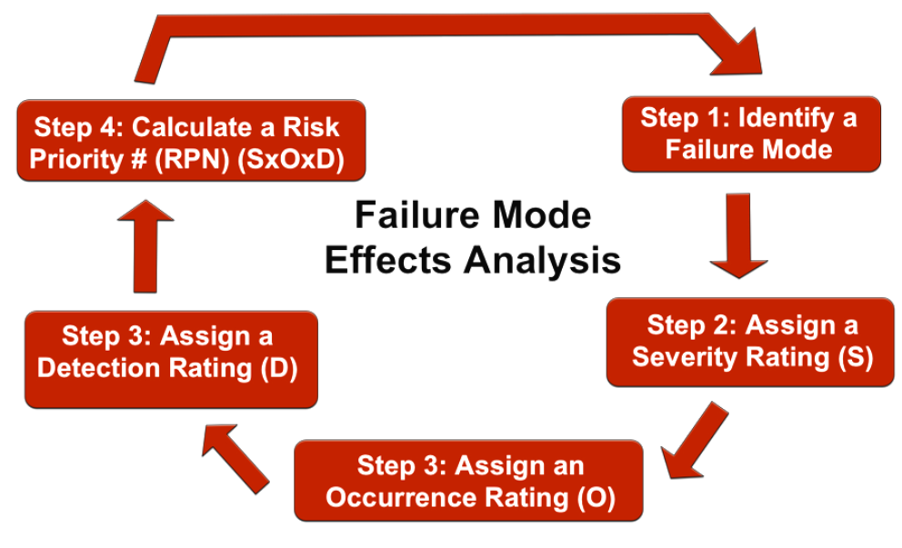
FMEA procedure
Step 5:
Step 4:

Slide 16
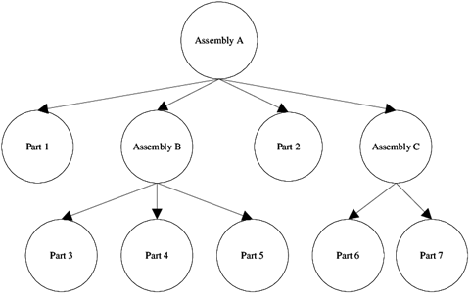
Tree diagram for a component

Slide 17
Step 1: Identify potential failure modes
There are many ways in which an asset can malfunction:
part/system performs an unintended function
poor performance
reduced functionality
failure to complete the intended function
Here are some “hidden” failure modes that are not easy to spot:
cracking
electrical short circuit
torque fatigue
excessive deformation

Slide 18
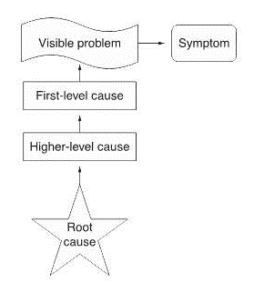
Step 2: Do a failure effect and cause analysis
Human error (like using the wrong type of material for load-bearing walls)
Material defects (like low-quality material due to the manufacturer’s poor standards)
Incorrect engineering requirements (like failing to follow engineering standards that stipulate minimum area requirements for a steel frame support)

Slide 19
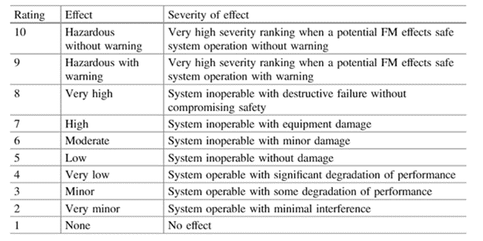
Step 3: Assign severity rankings
0: This failure has no measurable impact.
10: This failure would be dangerous and requires immediate intervention.

Slide 20
Step 4: Assign occurrence rankings
0: This failure is unlikely to ever happen.
10: This failure is virtually guaranteed.

Slide 21
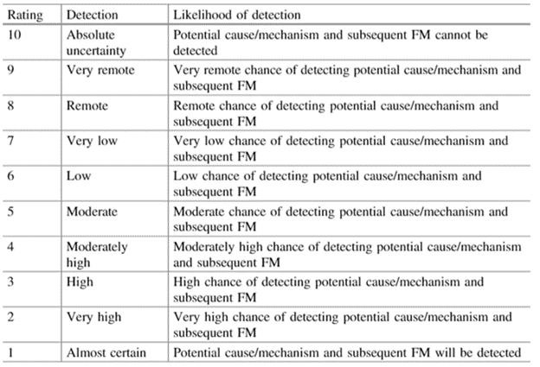
Step 5: Evaluate and assign failure detection rating
0: You are almost guaranteed to detect the failure early.
10: Neither the failure nor its possible causes can be detected.

Slide 22
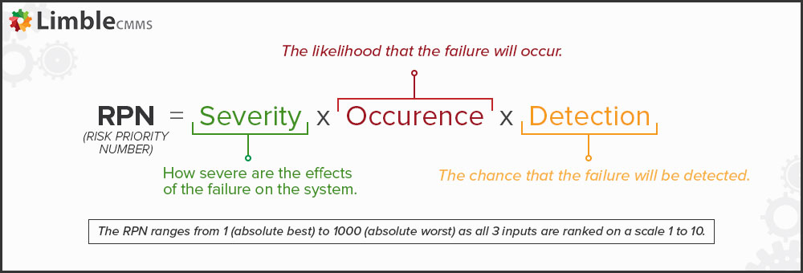
Step 6: Calculate RPN
A moderately severe failure (5 out of 10) with a very low chance of occurrence (2 out of 10) but also high difficulty of detection (8 out of 10) has an RPN of 80 (5 x 2 x 8).

Slide 23
FMEA - Procedure
1. For each process input (start with high value inputs), determine the ways in which the input can go wrong (failure mode)
2. For each failure mode, determine effects
  Select a severity level for each effect
3. Identify potential causes of each failure mode
  Select an occurrence level for each cause
4. List current controls for each cause
  Select a detection level for each cause

Slide 24
FMEA - Procedure
5. Calculate the Risk Priority Number (RPN)
6. Develop recommended actions, assign responsible persons, and take actions
  Give priority to high RPNs
  MUST look at severities rated a 10
7. Assign the predicted severity, occurrence, and detection levels and compare RPNs

Slide 25
FMEA – Inputs and Outputs
Inputs
Outputs
Brainstorming
C&E Matrix
Process Map
Process History
Procedures
Knowledge
Experience
List of actions to prevent causes or detect failure modes
History of actions taken
FMEA

Slide 26
Failure Modes and Effects
The relationship between failure modes and effects is not always 1 to 1.
Failure Mode 1
Effect 1
Failure Mode 2
Effect 2
Failure Mode 1
Effect 1
Failure Mode 2
Effect 1
Failure Mode 1
Effect 2

Slide 27
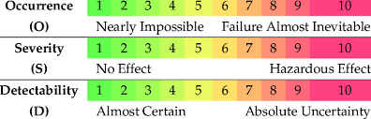
Severity, Occurrence, and Detection
Severity
  Importance of the effect on customer requirements
  Often can’t do anything about this
Occurrence
  Frequency with which a given cause occurs and creates failure modes
Detection
  The ability of the current control scheme to detect or prevent a given cause

Slide 28
Rating Scales
There are a wide variety of scoring “anchors”, both quantitative or qualitative
Two types of scales are 1-5 or 1-10
The 1-5 scale makes it easier for the teams to decide on scores
The 1-10 scale allows for better precision in estimates and a wide variation in scores (most common)

Slide 29
Rating Scales
Severity
  1 = Not Severe, 10 = Very Severe
Occurrence
  1 = Not Likely, 10 = Very Likely
Detection
  1 = Likely to Detect, 10 = Not Likely to Detect

Slide 30
THANK YOU!!!

